Slide 1


230 Java SL VA - RLL Group 2
Project : Employee Payroll Management

Slide 2


Group 2 : Team members
Group | Id | Name
2 | 2564013 | Srishti Daga
2 | 2563553 | Anikit Sahoo
2 | 2563548 | Akshay Kailassing Pardeshi
2 | 2563771 | Kalpanasri Balasubramani
2 | 2564324 | Kyana Shravya
2 | 2563441 | Mandadi Harish
2 | 2563216 | P Yamini
2 | 2563033 | Rahul B P

Slide 3

Contents :
Introduction
Objectives
System requirements
Tools and Technologies
Features
Flow of Application
Data Flow
Advantages
Working of project
JUnit
Postman testing
Conclusion

Slide 4
Introduction
Employee payroll management system is an Internet-based Java application that automates the working of a company or work center that manage and maintain records of the employees
leaves, work,
attendance and
salary.
Payroll System is compatible with existing back-end systems to handle the heavy lifting of calculating time, wages and attendance reports.

Slide 5

Objective
The Primary objective of the design is to deliver the requirement as delivered by the feasibility report. There are some objective we kept in mind.
Practically : The system is quite stable and can be operated by the Employees with average intelligence.
Efficiency : We tried to improve accuracy and productivity.

Slide 6

Tools & Languages
Front End
Back End
Visual Studio
Angular
HTML
CSS
BOOTSTRAP
Spring Tool Suite
MySQL
Spring boot
Postman
JUnit

Slide 7

Features
User friendly.
Easy to use. ​It is completely secure.
​This system is easily compatible with most of the web browsers.
​Admin can access all the records .
Store the end-end data of employees & Admins.

Slide 8

Advantages
Helps the admin easy way to access the employee data
The information related to employee can be added and removed easily
Store the end-to-end data of the employees
Helps the employee easy way to access their data

Slide 9
Block Diagram
EMPLOYEE MANAGEMENT
WORK SCHEDULE MANAGEMENT
SALARY MANAGEMENT
PAYROLL MANAGEMENT SYSTEM
TIMESHEET MANAGEMENT
ATTENDANCE MANAGEMENT
LEAVE MANAGEMENT
REGISTRATION MANAGEMENT
LOGIN MANGEMENT

Slide 10

(Admin Operations)

Slide 11
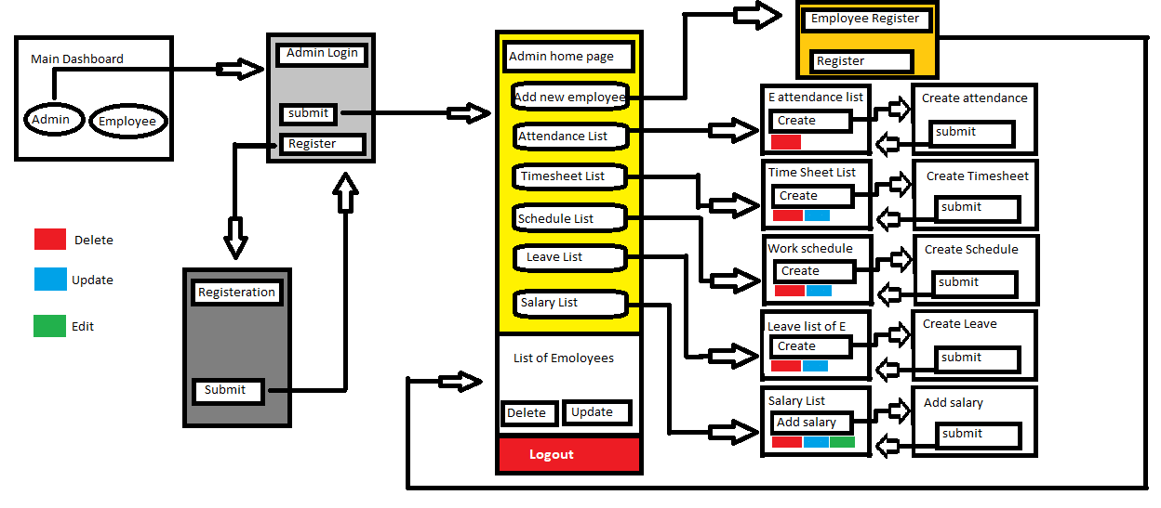
Admin Flow

Slide 12
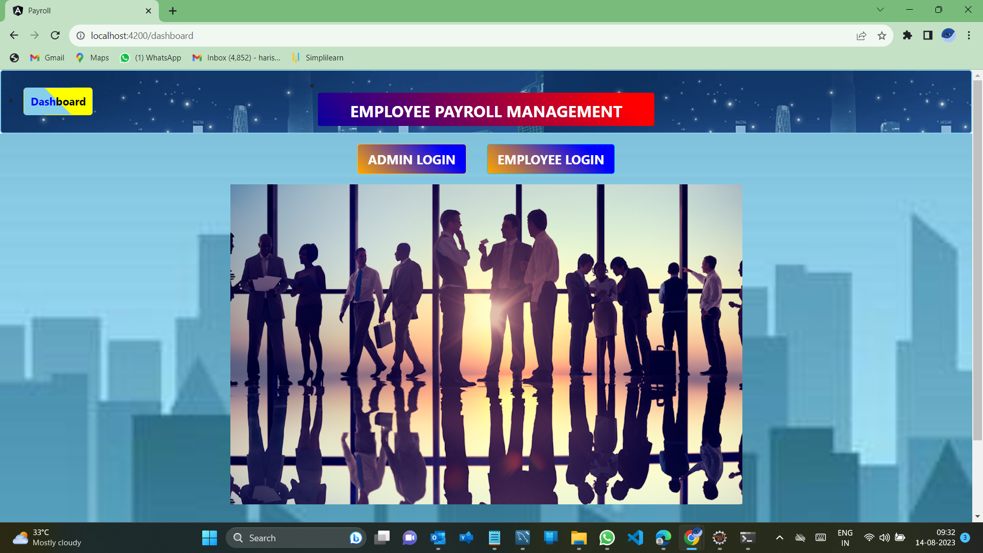
Dashboard

Slide 13
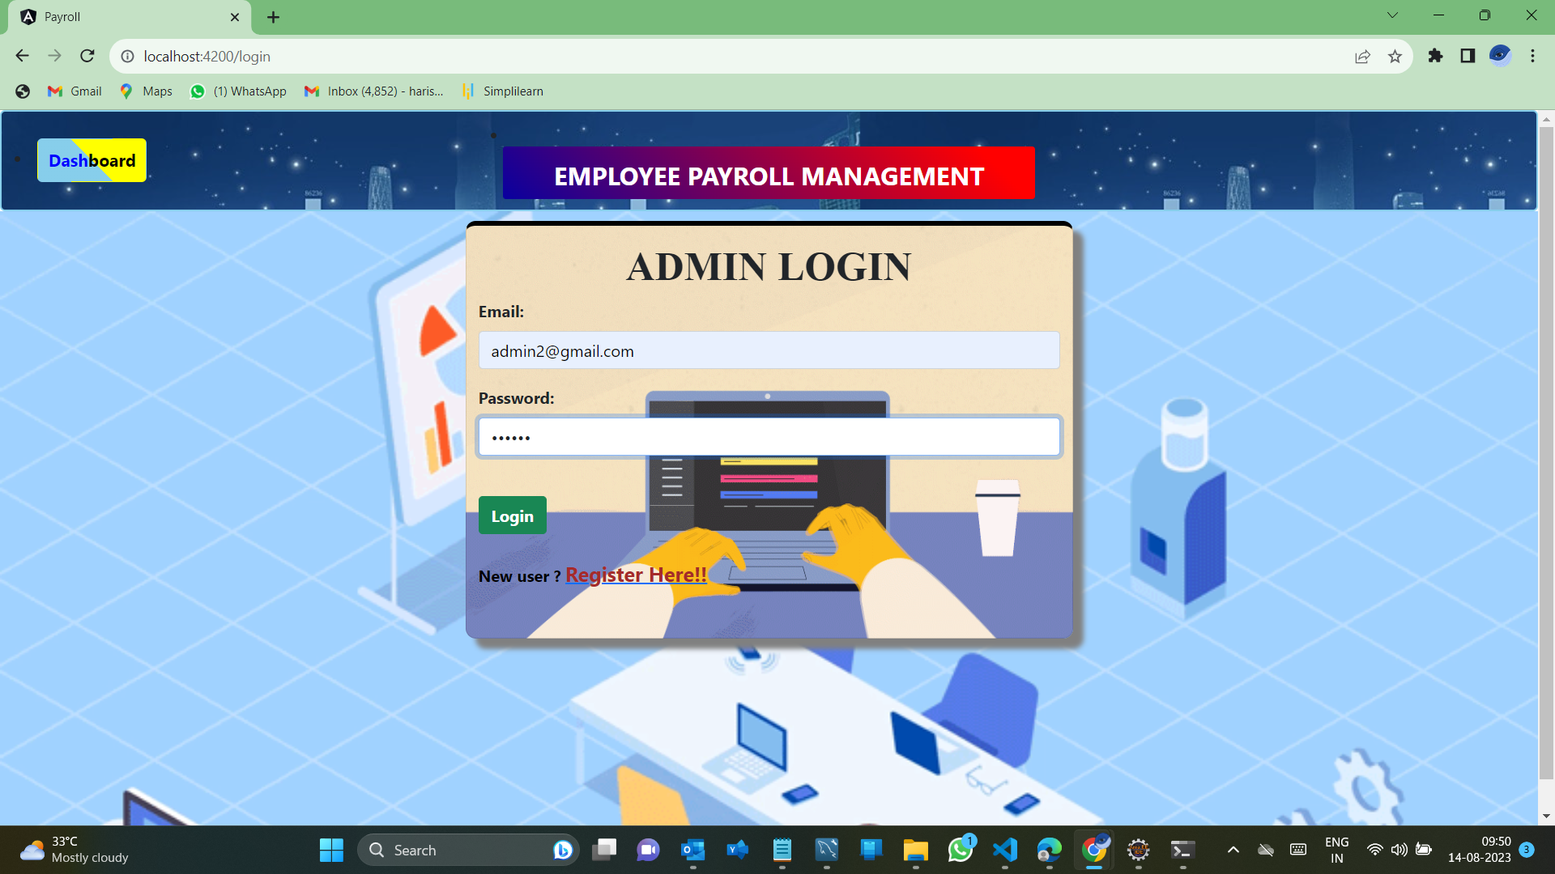
Admin Login
Admin Login

Slide 14
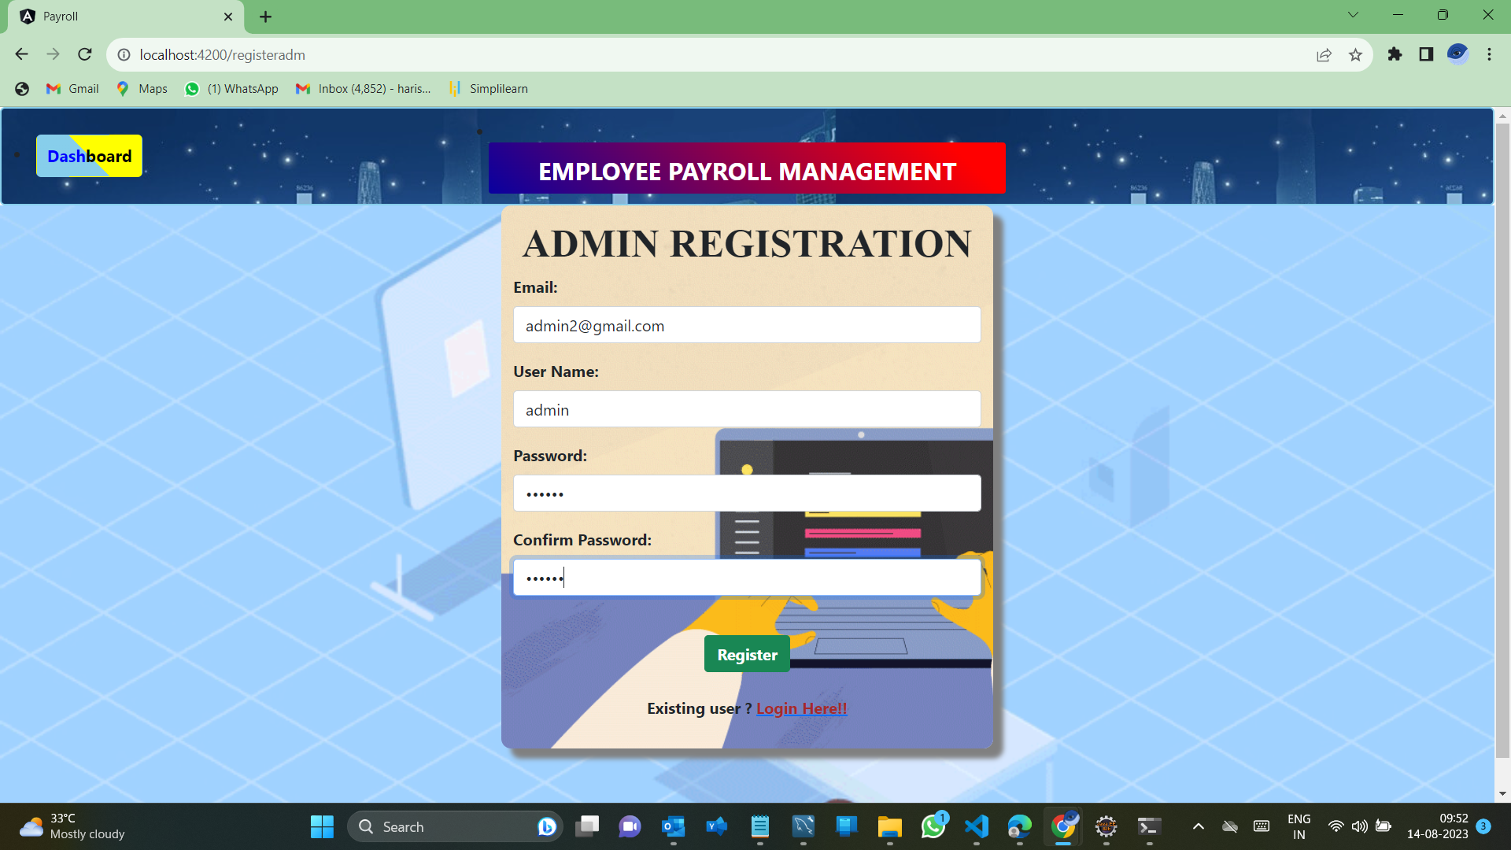
Admin Registration

Slide 15

Admin Dashboard
In the admin dashboard, there are 6 components which perform respective functionality,they are:
Add new employee
Attendance list
Timesheet list
Work schedule list
Leave list
Salary list

Slide 16
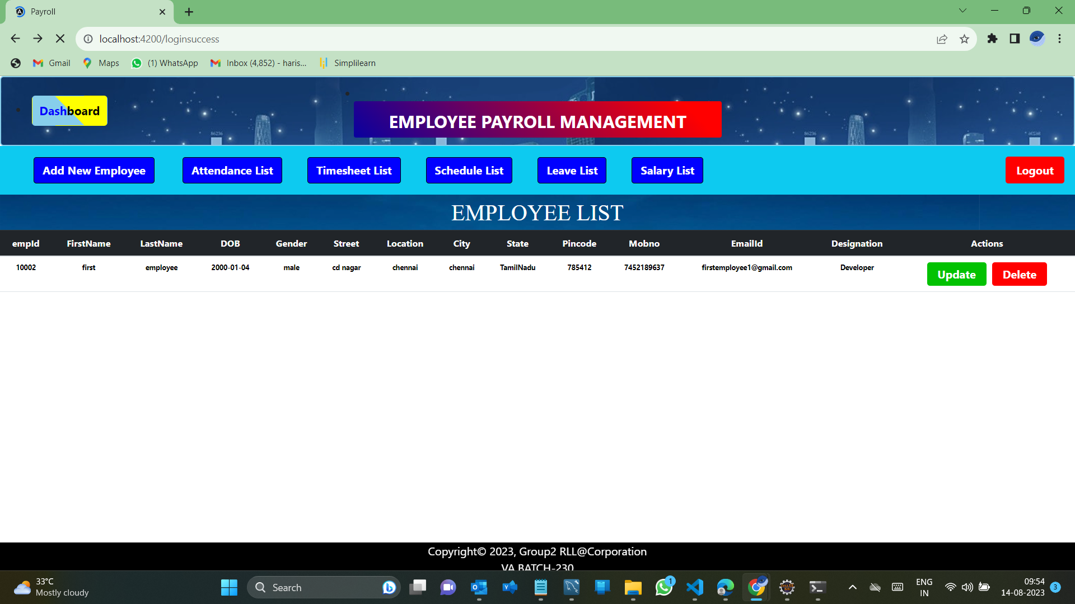
Admin Dashboard

Slide 17

Employee Management System
Add Employee
Update Employee
Delete Employee

Slide 18
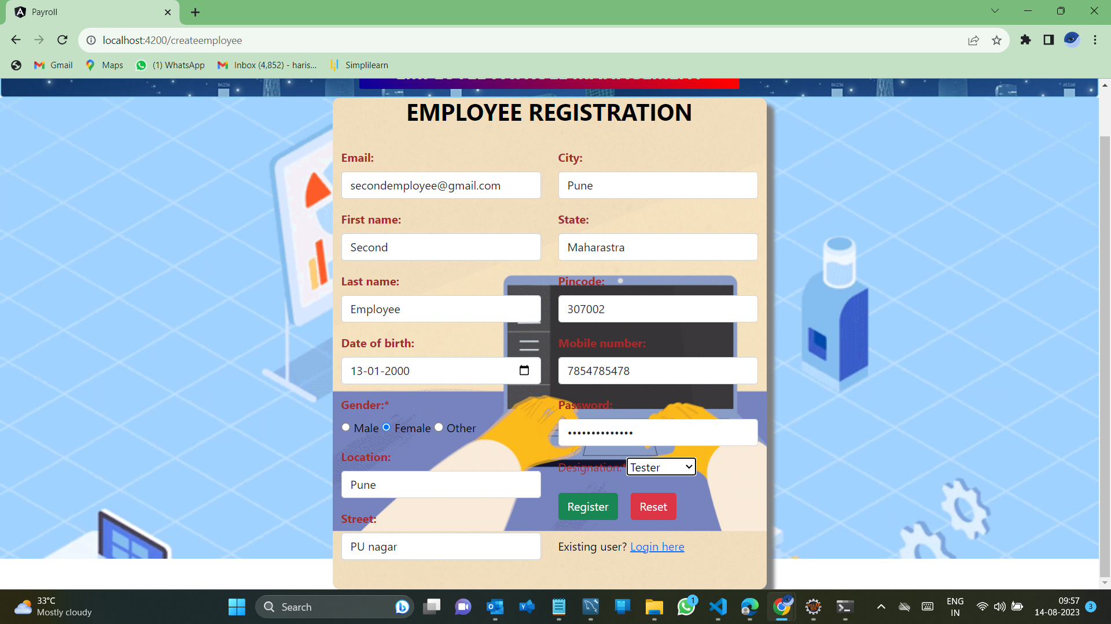
Add Employee(by Admin)

Slide 19
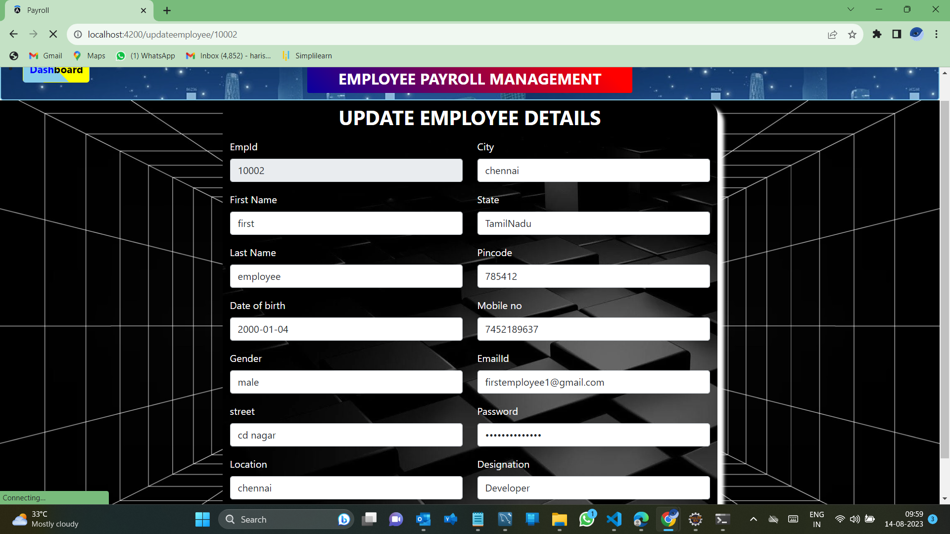
Edit Employee
Update Employee details(by Admin)

Slide 20

Work Schedule list
Create Schedule
View Schedule
Update Schedule
Delete Schedule

Slide 21
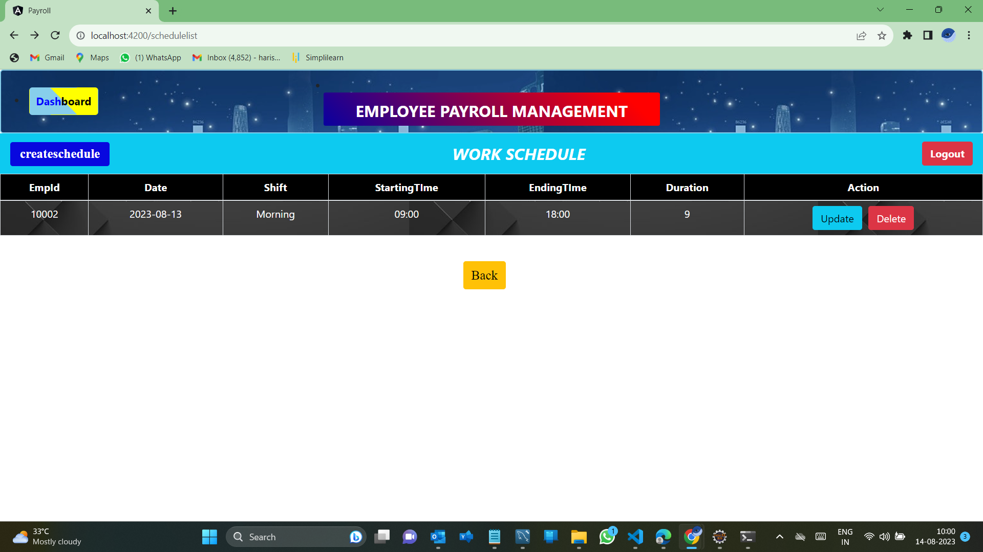
Work schedule List

Slide 22
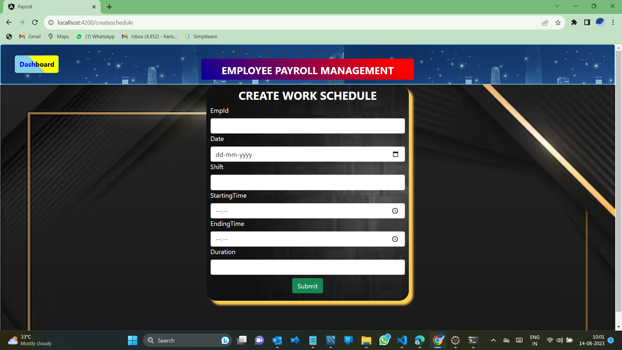
Creating the Work schedule

Slide 23
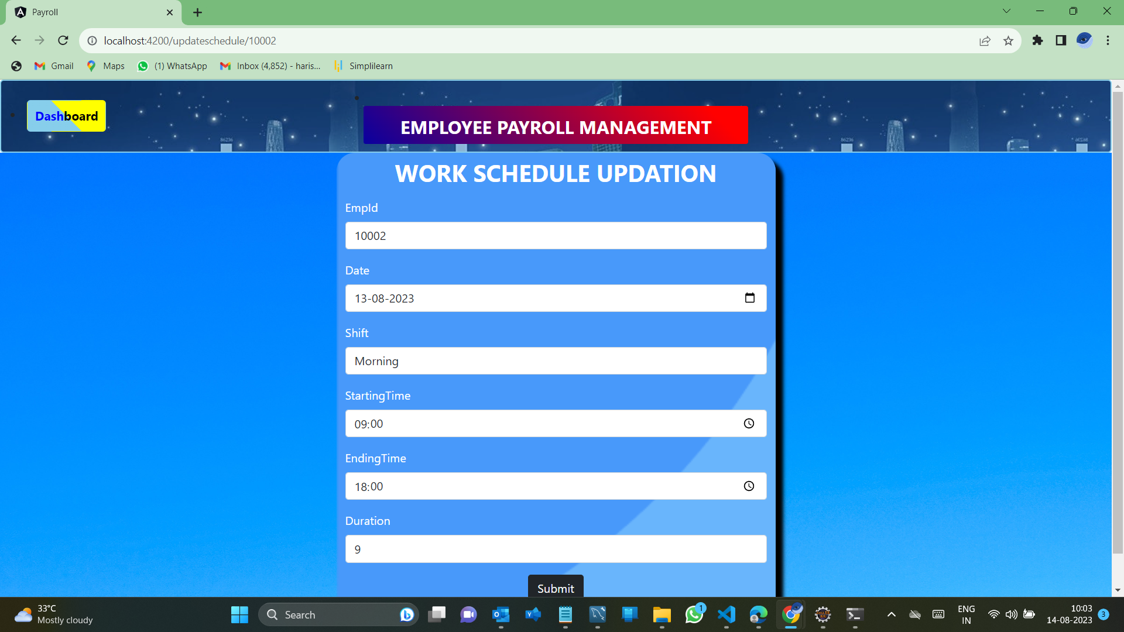
Updating the Work schedule

Slide 24

Time sheet list
Create Timesheet
View Timesheet
Update Timesheet
Delete Timesheet

Slide 25
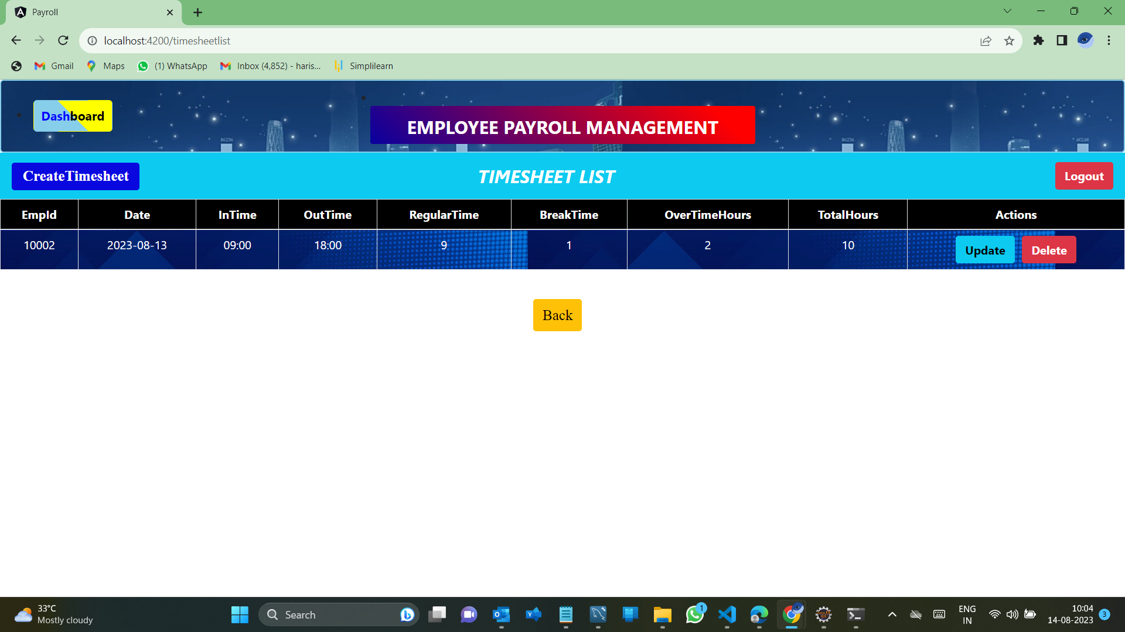
Time sheet List

Slide 26
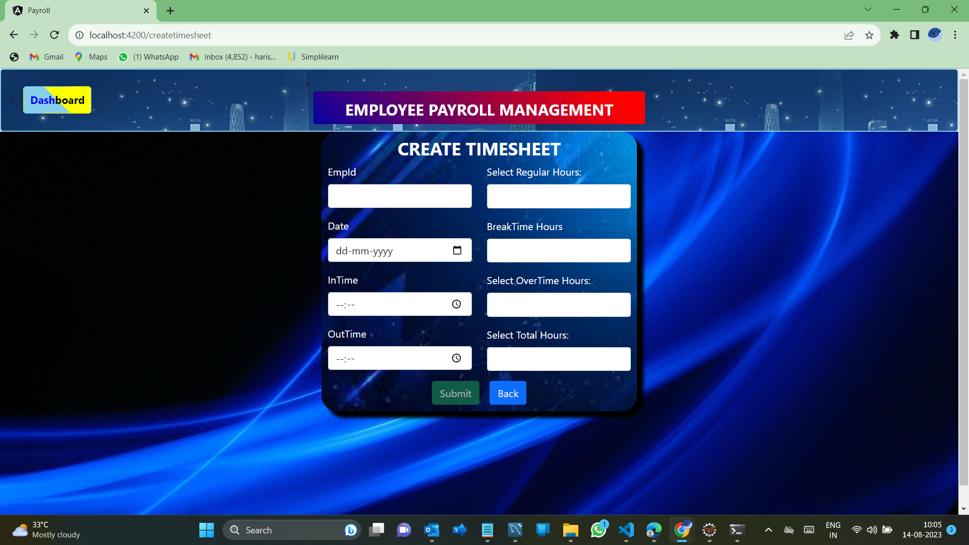
Creating the time sheet list

Slide 27
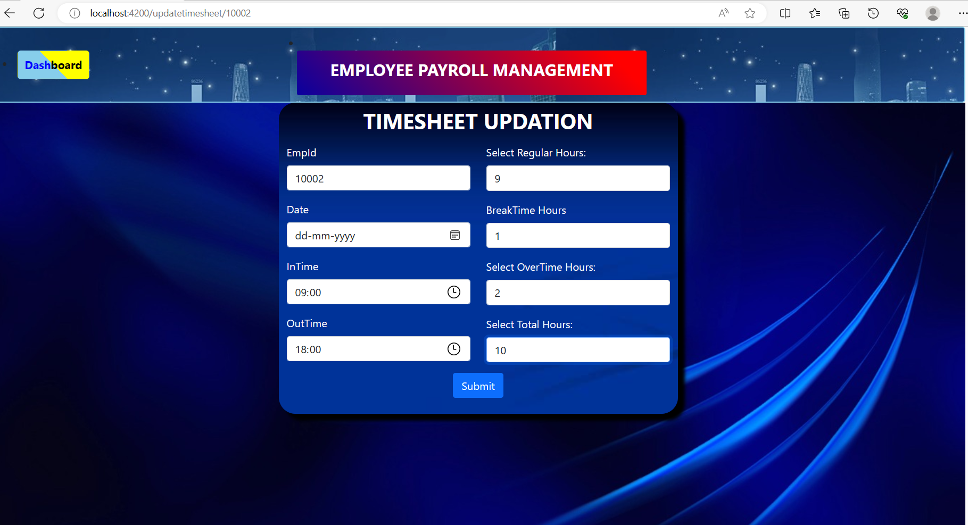
Updating Time sheet

Slide 28

Attendance List
Create Attendance list
View Attendance list
Delete Attendance list

Slide 29
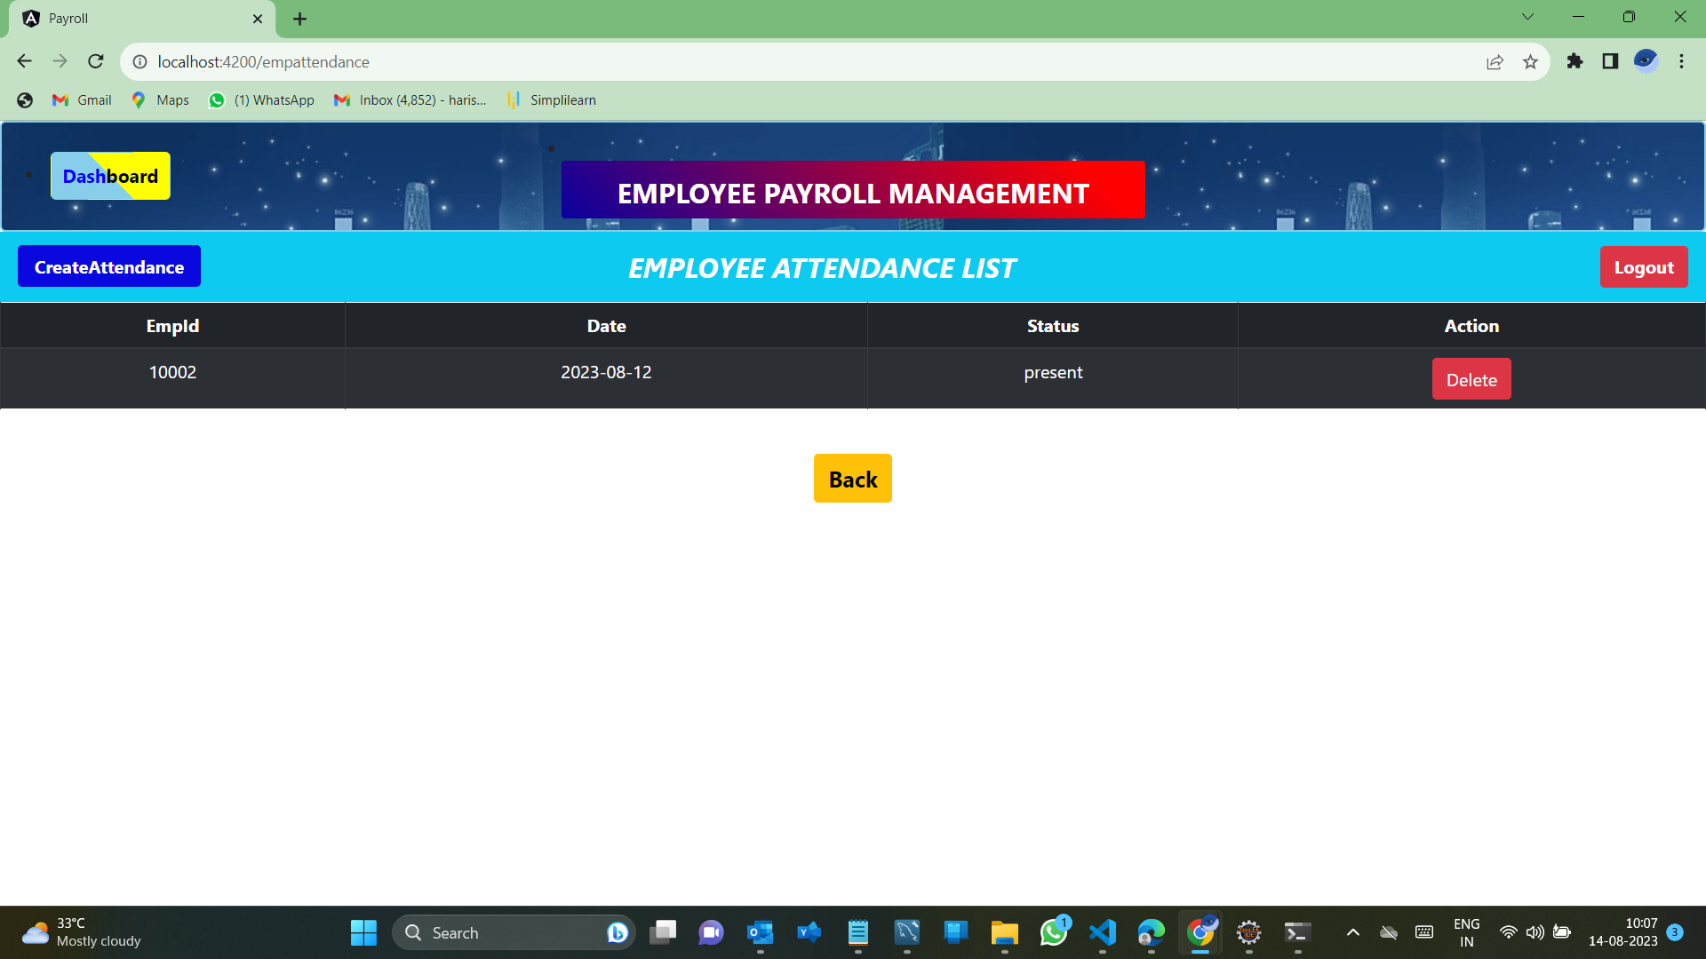
Attendance List

Slide 30
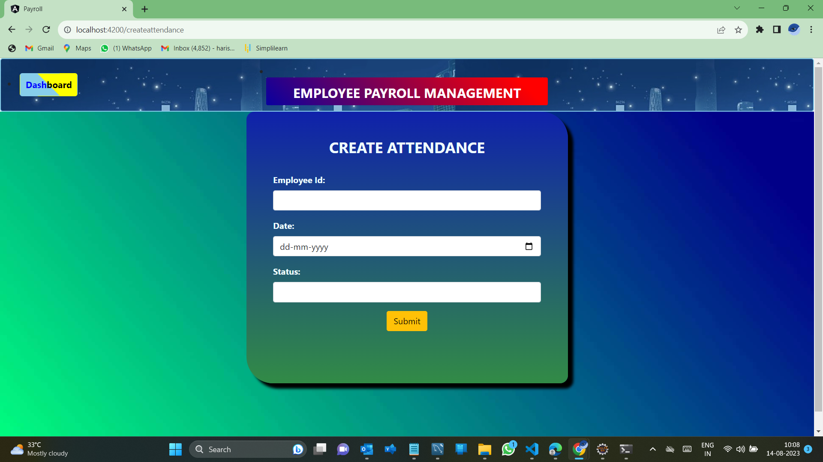
Creating the Attendance List

Slide 31

Leave List
Create Leave list
View Leave list
Delete Leave list

Slide 32
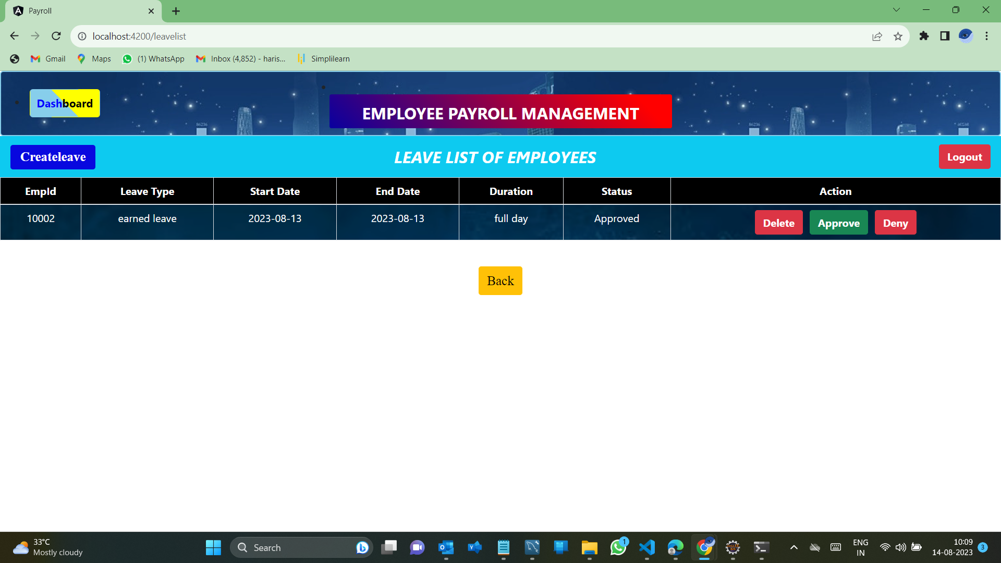
Leave list

Slide 33
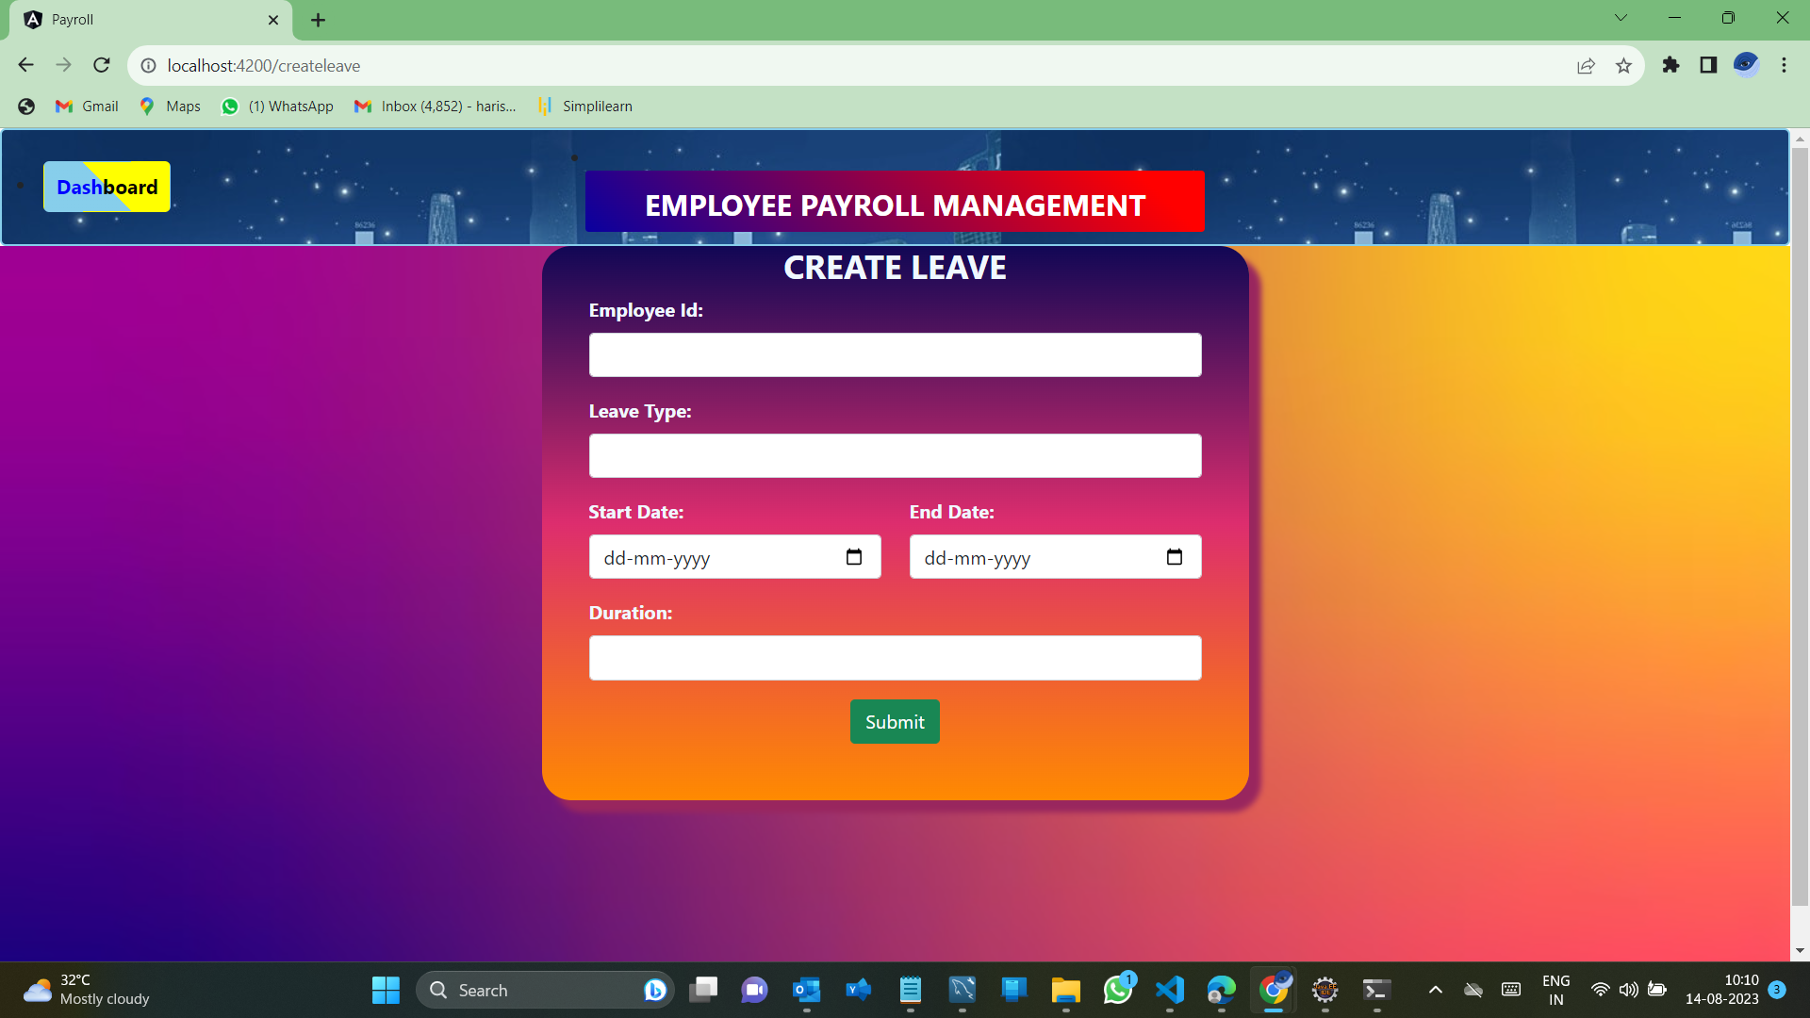
Creating the Leave list

Slide 34

Salary List
Create Salary List
View Salary List
Update Salary List
Delete Salary List

Slide 35
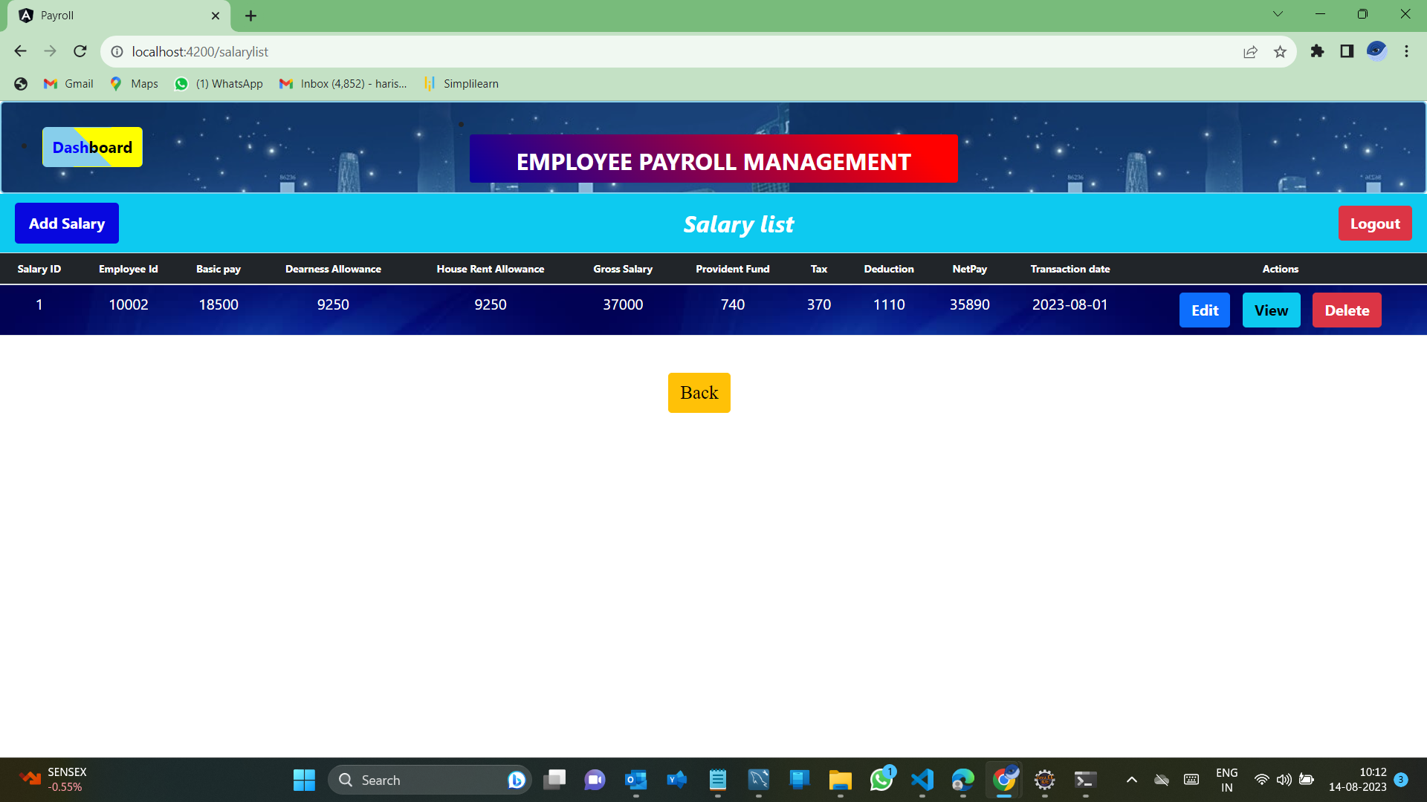
Salary list of employees

Slide 36
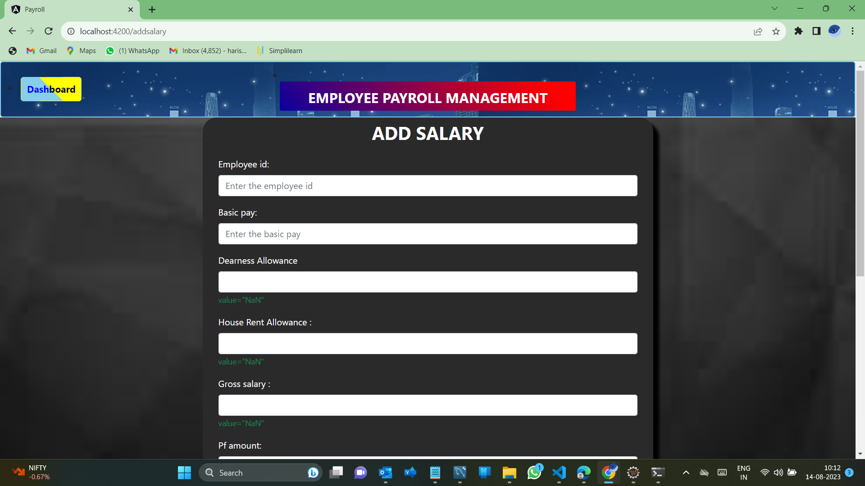
Adding the salary to the employee

Slide 37
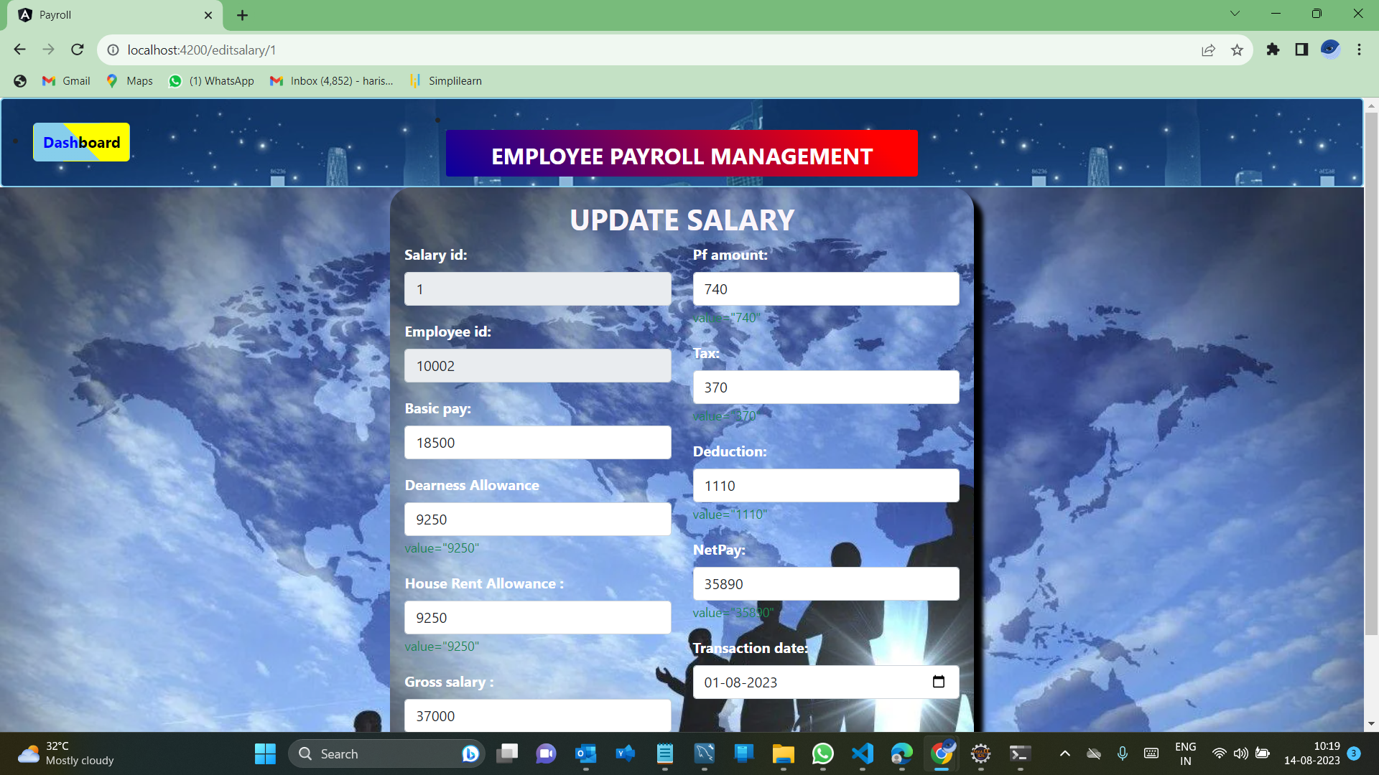
Updating the salary

Slide 38
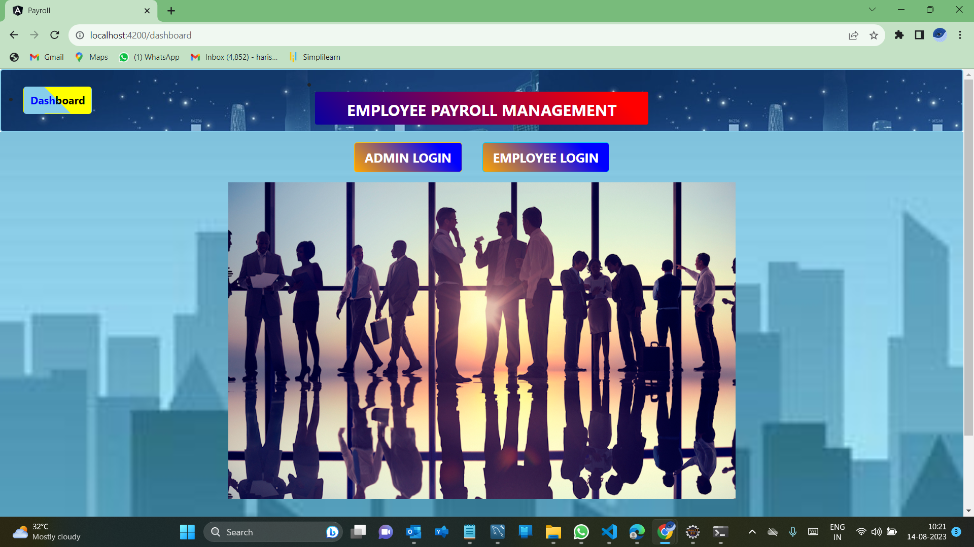
Returning To Dashboard

Slide 39

Salary list of employees

Slide 40
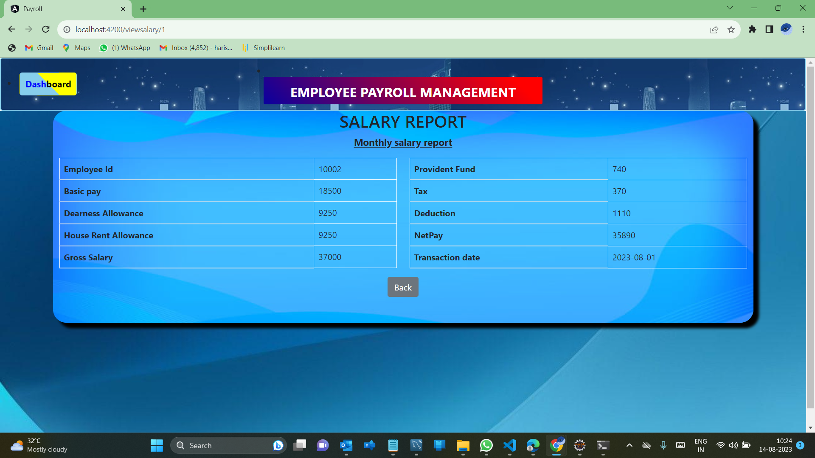
Payslip

Slide 41
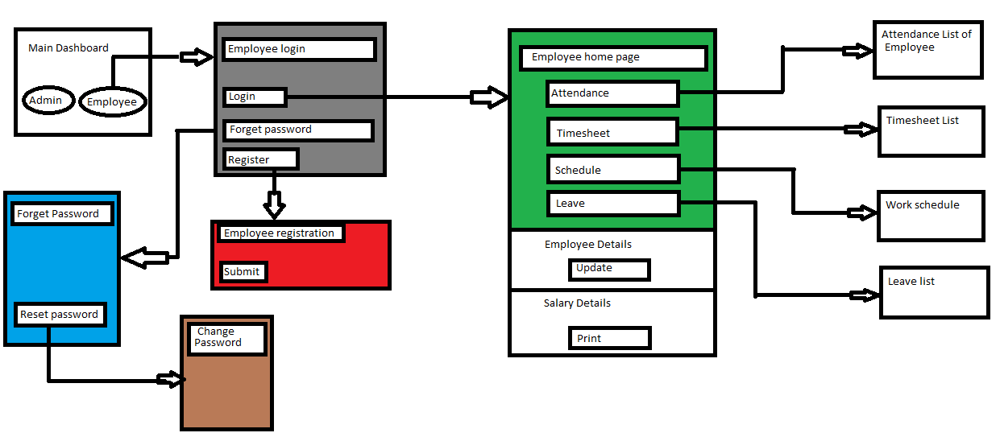
Employee Flow

Slide 42
(Employee Operations)

Slide 43

Returning To Dashboard

Slide 44
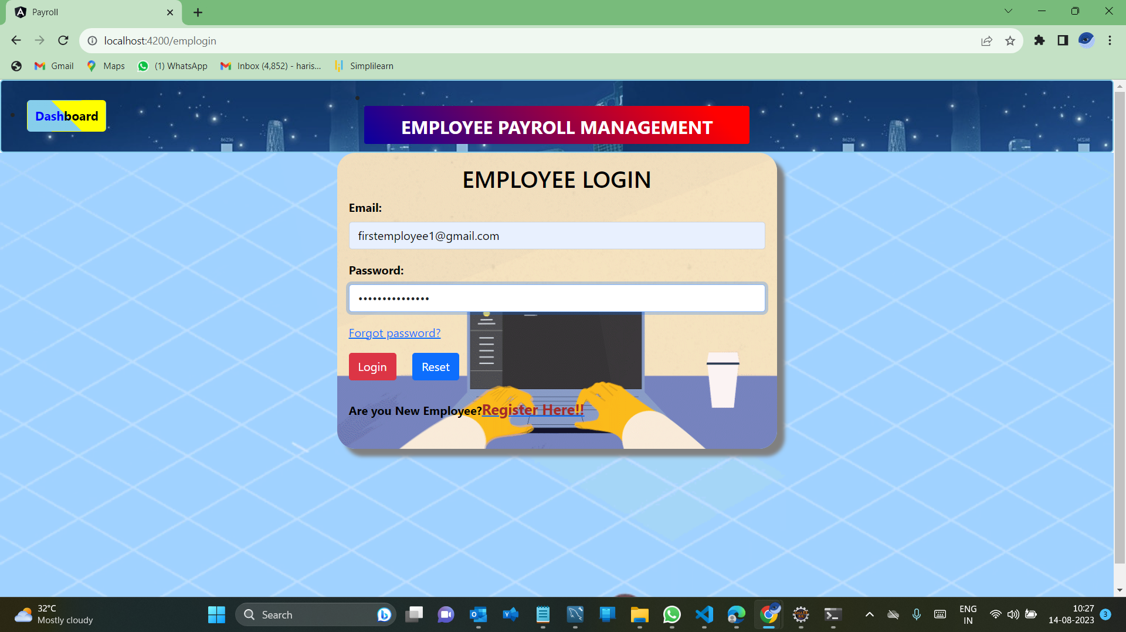
Employee signup
Employee Login

Slide 45
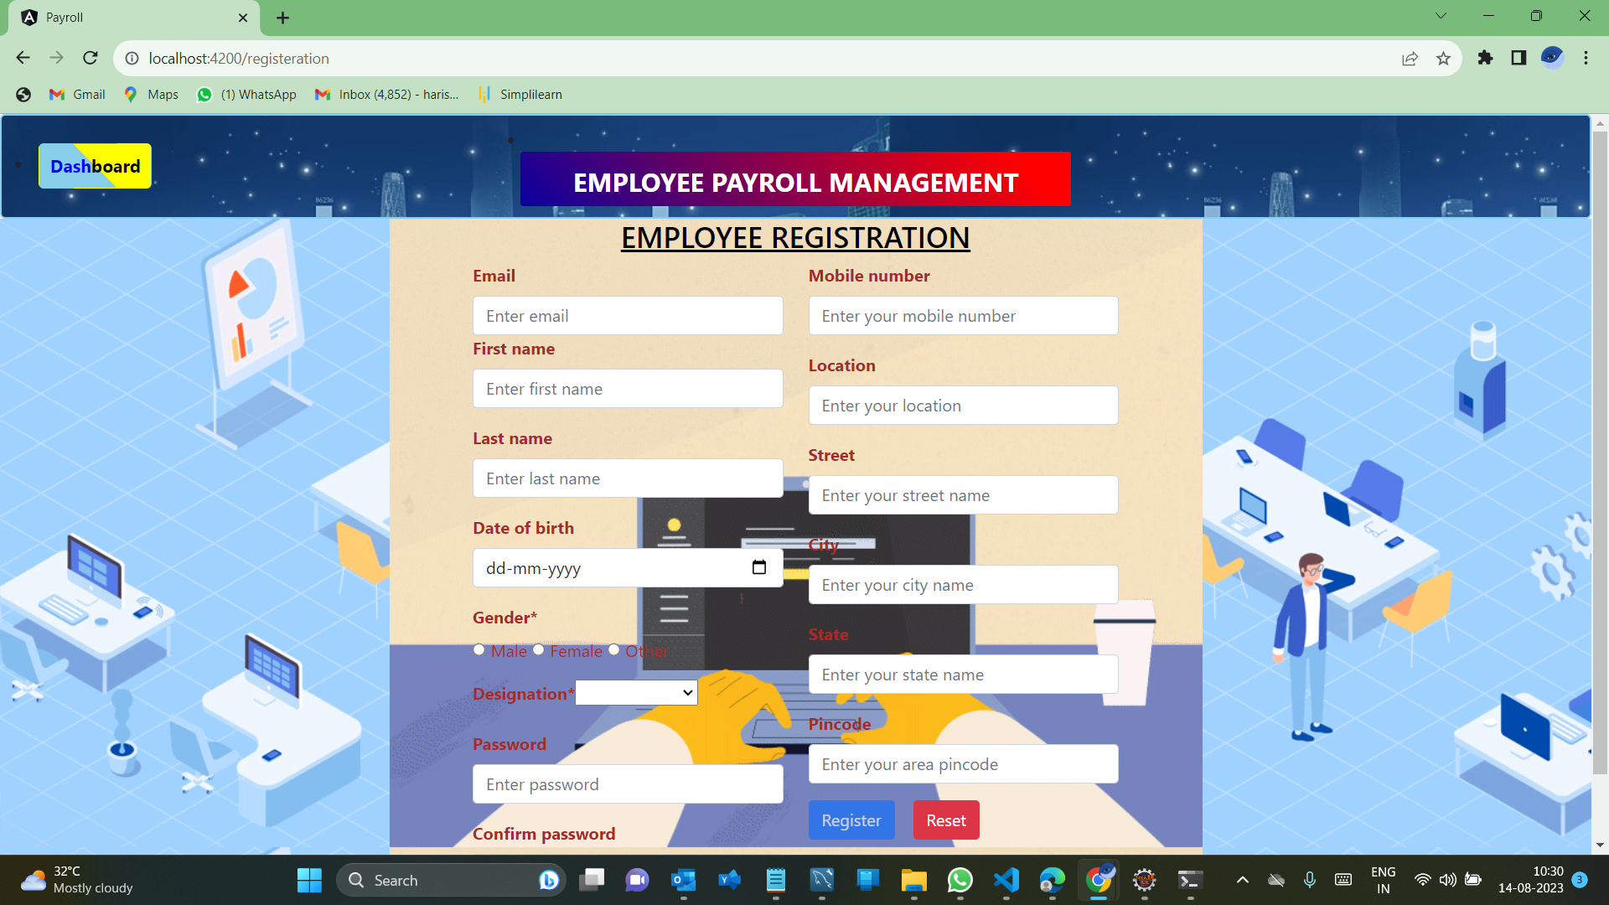
Employee Registration(by Employee)

Slide 46
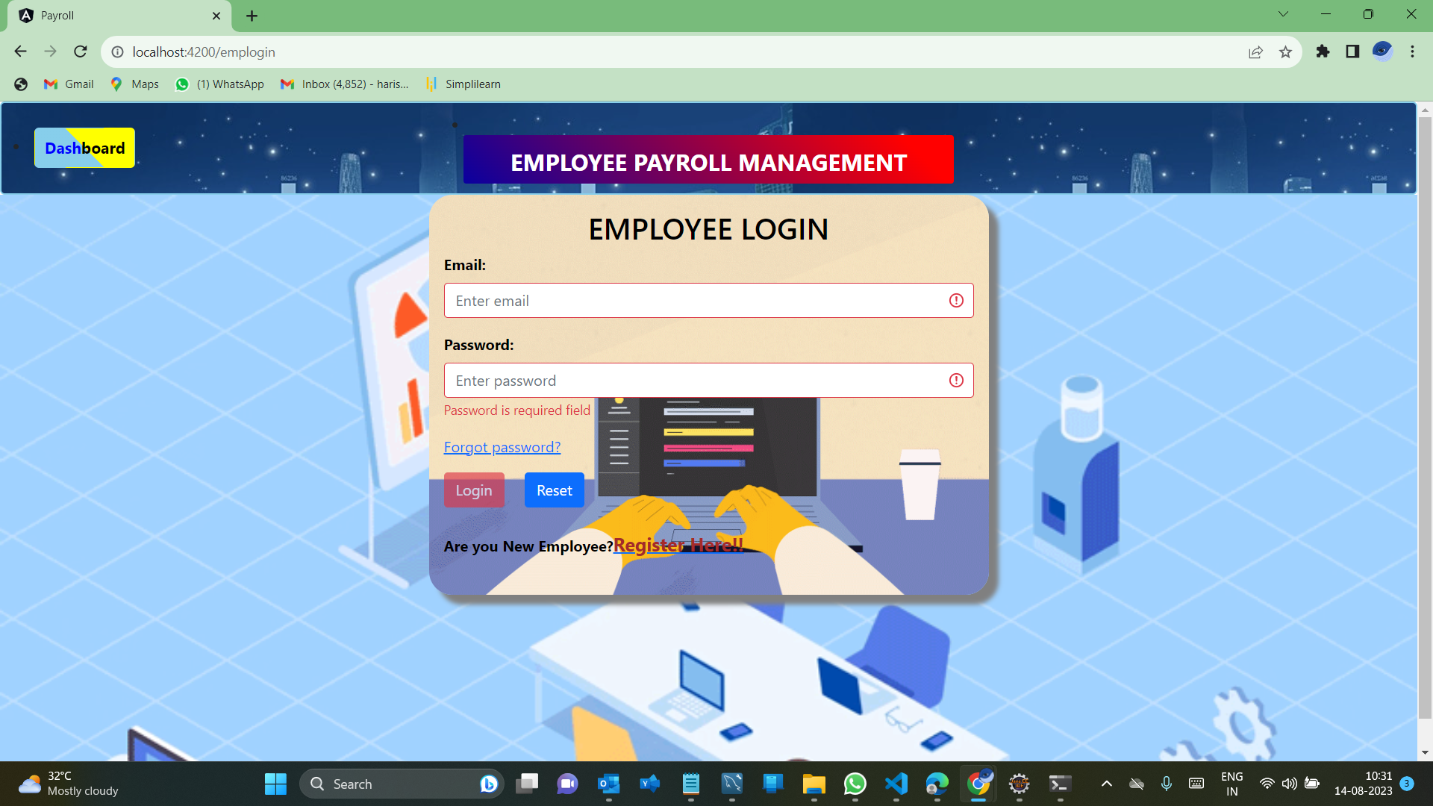
Employee signup
Employee Login

Slide 47
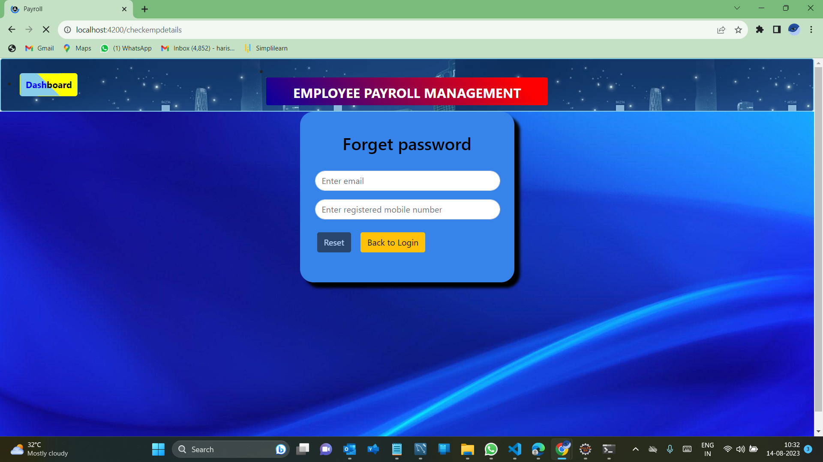
Forgot Password

Slide 48
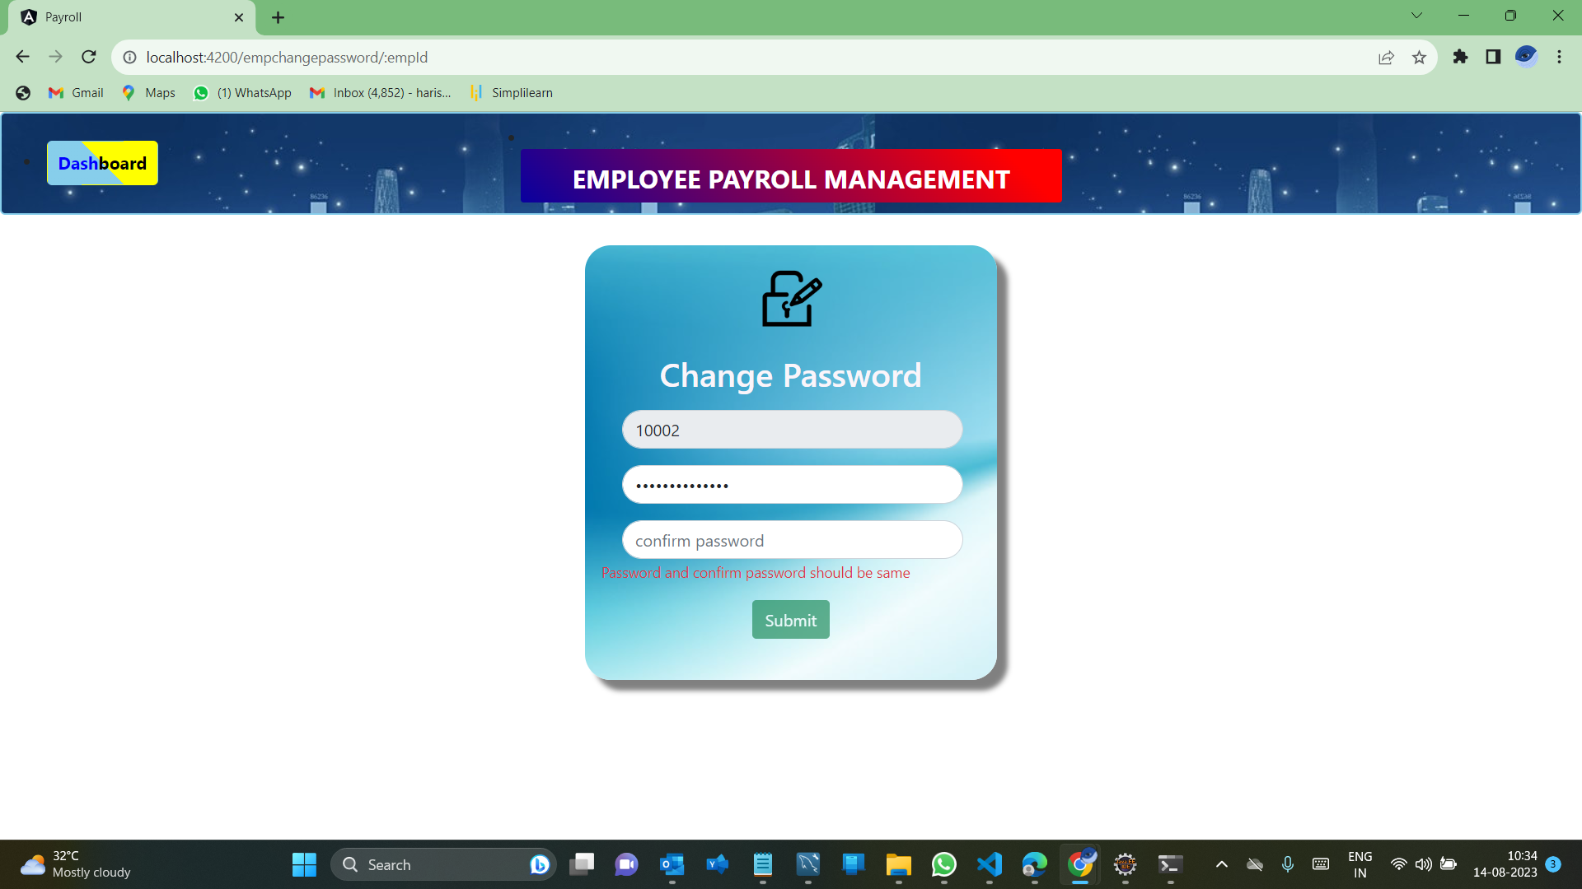
Change Password

Slide 49

Employee Dashboard
After successful login of employee, there will be a dashboard with 5 main components that can perform respective functionality.
They are:
Salary details
Attendance
Timesheet
Schedule
Leave

Slide 50
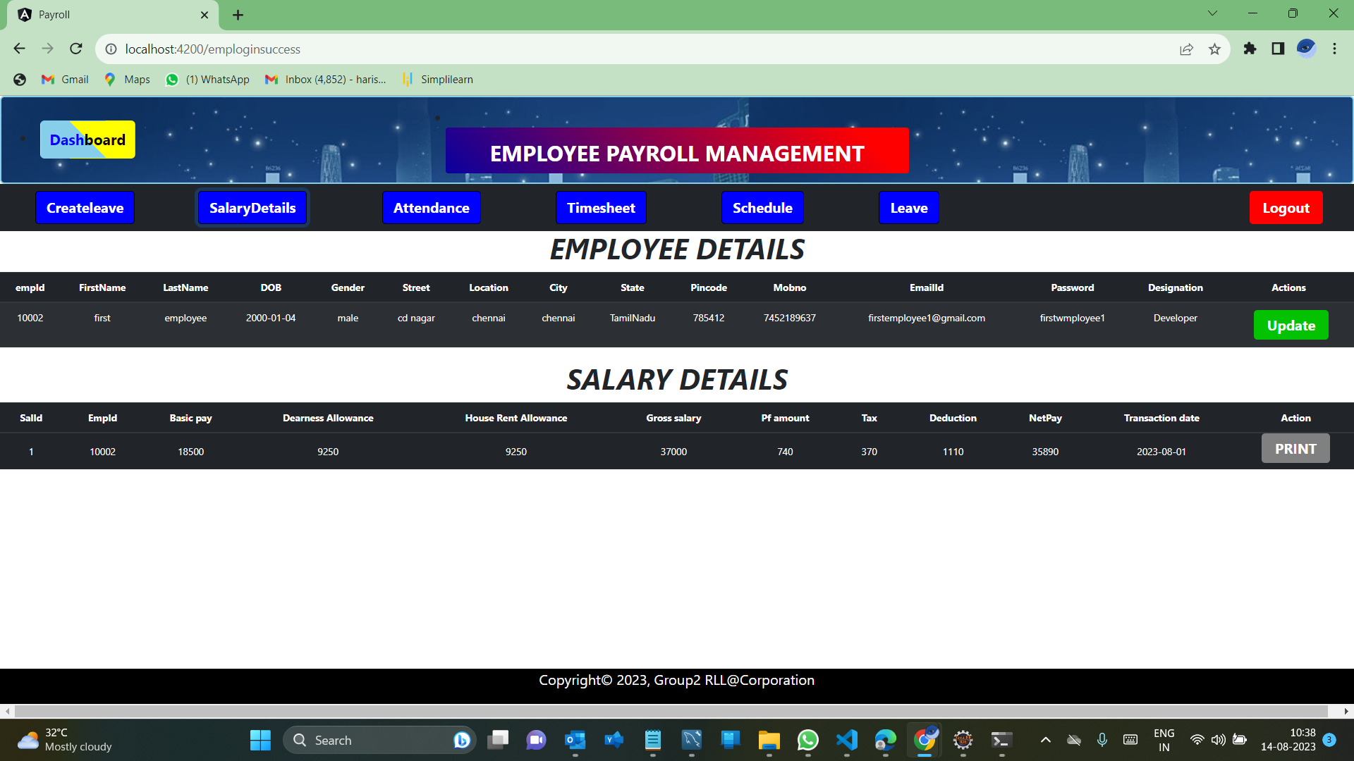
Employee Home page

Slide 51
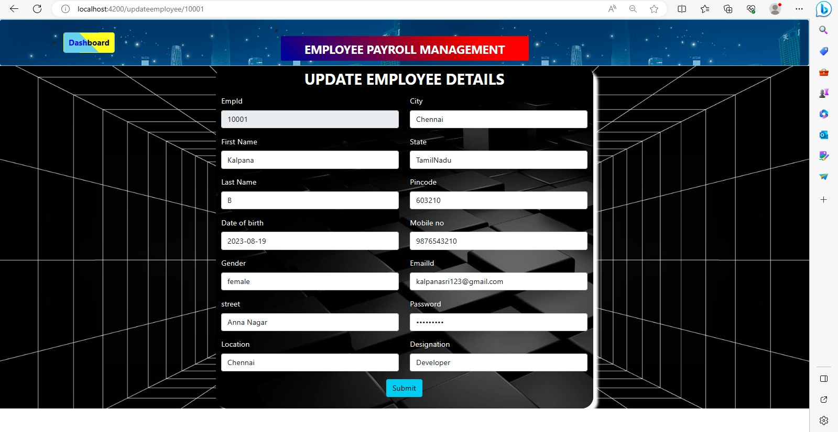
Update the Employee details

Slide 52
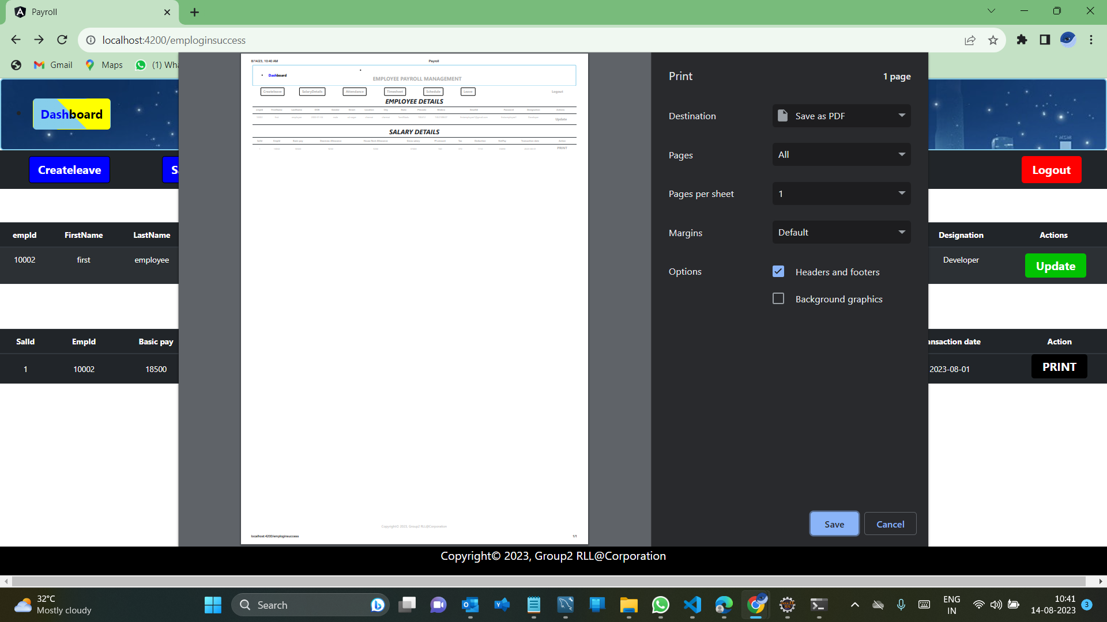
Taking the print of Salary details

Slide 53
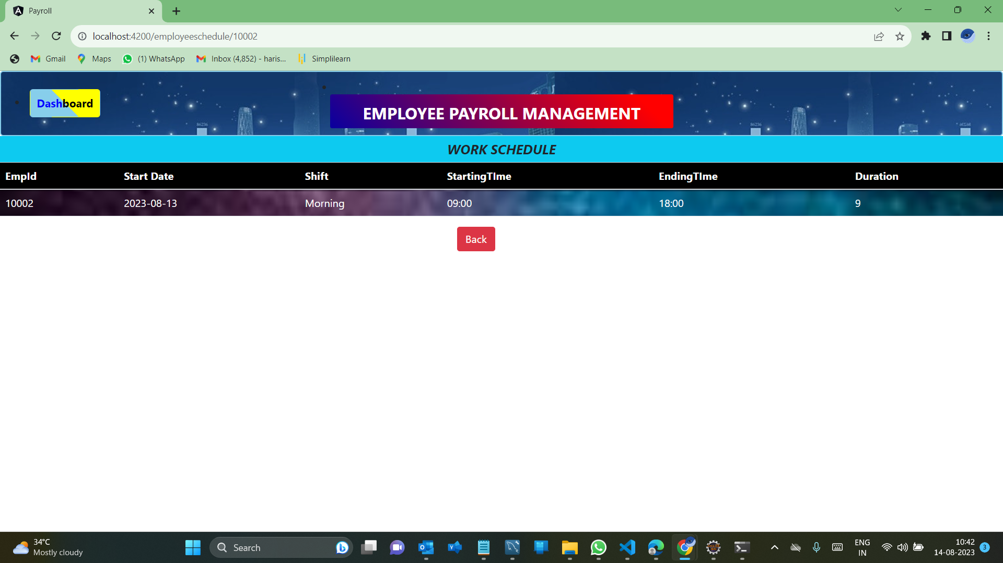
Employee can view the Work Schedule list

Slide 54
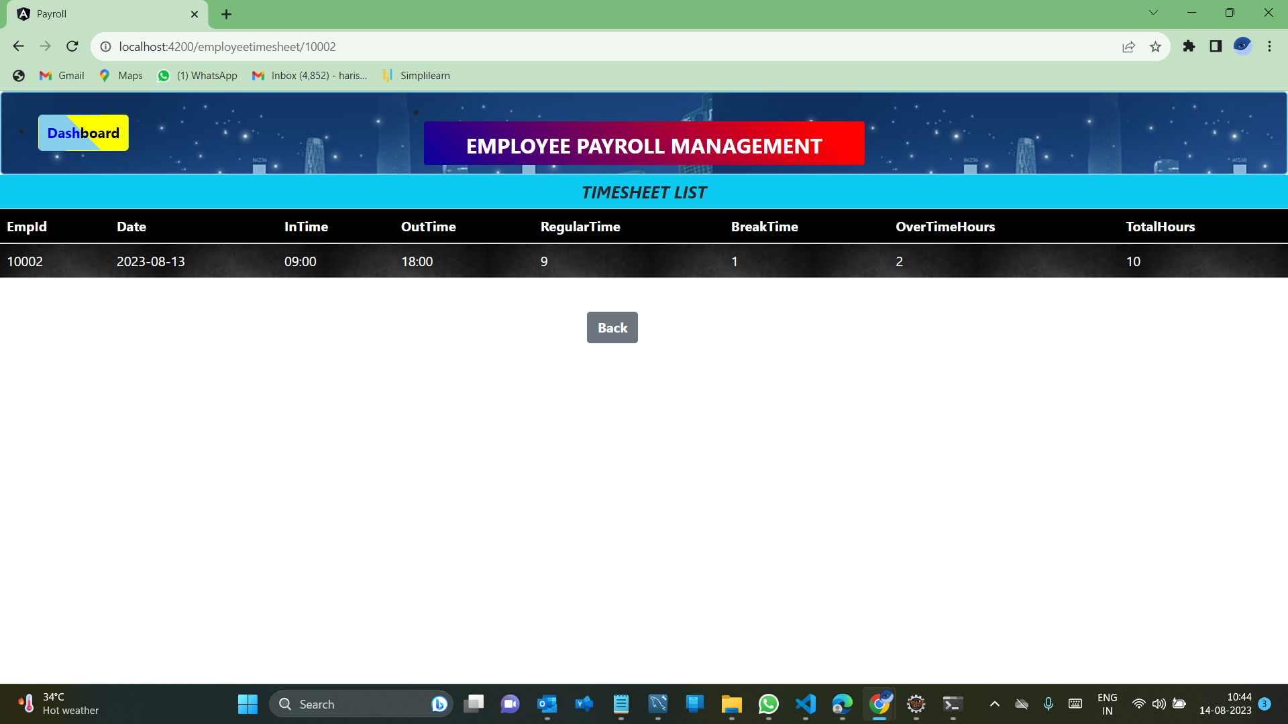
Employee can view the timesheet list

Slide 55
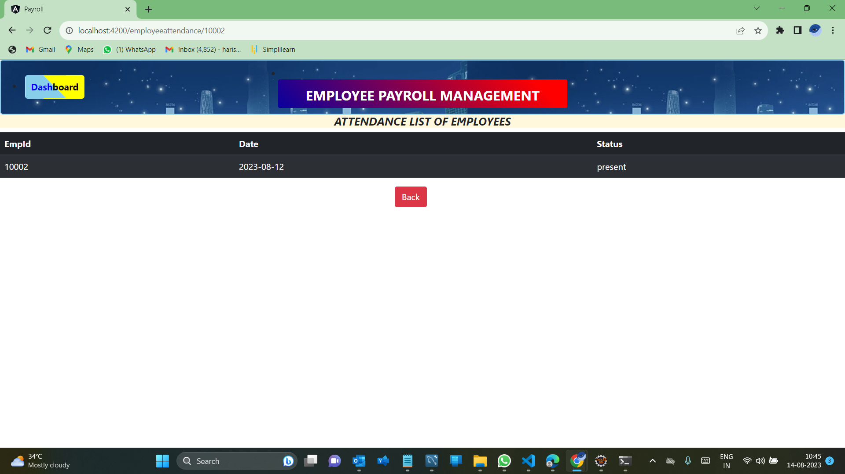
Employee can view the Attendance list

Slide 56
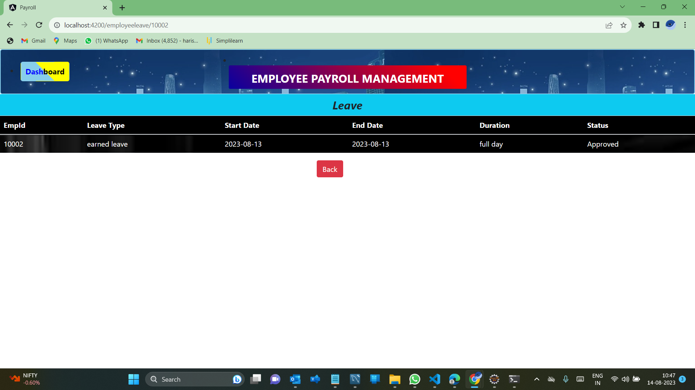
Employee can view the Leave list

Slide 57
Employee APIs
HTTP methods | URL | Operation
GET | http://localhost:8080/employeepayroll/ad/admins | To retrieve all the employees
POST | http://localhost:8080/employeepayroll/ad/admins | To create/register the new employee
GET | http://localhost:8080/employeepayroll/ad/{empId} | To get the specific employee details
PUT | http://localhost:8080/employeepayroll/ad/{empId} | To update the specific employee details
DELETE | http://localhost:8080/employeepayroll/ad/{empId} | To delete the specific employee details

Slide 58
Admin APIs
HTTP methods | URL | Operation
POST | http://localhost:8080/register | To register the admin details
POST | http://localhost:8080/login | To login the admin

Slide 59
Attendance APIs
HTTP methods | URL | Operation
GET | http://localhost:8080/employeepayroll/attend/{empid} | To get the attendance of particular employee
GET | http://localhost:8080/employeepayroll/attend/attendances | To get the attendances of all the employees
POST | http://localhost:8080/employeepayroll/attend/attendances | To create the attendance of particular employee
DELETE | http://localhost:8080/employeepayroll/attend/attendances/{empid} | To delete the attendance of particular employee

Slide 60
Leave APIs
HTTP methods | URL | Operation
GET | http://localhost:8080/employeepayroll/leave/{empid} | To get the leave list of particular employee
GET | http://localhost:8080/employeepayroll/leave/leaves | To get the leave list of all the employees
POST | http://localhost:8080/employeepayroll/leave/leaves | To create the leave list of particular employee
DELETE | http://localhost:8080/employeepayroll/leave/leaves/{empid} | To delete the leave list of particular employee

Slide 61
Work Schedule APIs
HTTP methods | URL | Operation
GET | http://localhost:8080/employeepayroll/schedule/schedules/{empid} | To get the work schedule of particular employee
GET | http://localhost:8080/employeepayroll/schedule/schedules | To get the Work schedule of all the employees
POST | http://localhost:8080/employeepayroll/schedule/schedules | To create the Work schedule of particular employee
DELETE | http://localhost:8080/employeepayroll/schedule/schedules/{empid} | To delete the Work schedule of particular employee
PUT | http://localhost:8080/employeepayroll/schedule/schedules/{empid} | To update the Work schedule of particular employee

Slide 62
Time sheet list APIs
HTTP methods | URL | Operation
GET | http://localhost:8080/employeepayroll/time/timesheets/{empid} | To get the time sheet list of particular employee
GET | http://localhost:8080/employeepayroll/time/timesheets | To get the time sheet list of all the employees
POST | http://localhost:8080/employeepayroll/time/timesheets | To create the time sheet for particular employee
DELETE | http://localhost:8080/employeepayroll/time/timesheet/{empid} | To delete the time sheet for particular employee
PUT | http://localhost:8080/employeepayroll/time/timesheets/{empid} | To update the time sheet for particular employee

Slide 63
Salary list APIs
HTTP methods | URL | Operation
GET | http://localhost:8080/employeepayroll/salary/salaries/{id} | To get the salary list by salary id
GET | http://localhost:8080/employeepayroll/salary/salaries | To return the all the salary list
POST | http://localhost:8080/employeepayroll/salary/salaries | To create the salary list for particular employee
POST | http://localhost:8080/employeepayroll/salary/editsalaries | To edit the salary list for particular employee
DELETE | http://localhost:8080/employeepayroll/salary/salaries/{id} | To delete the salary list for particular employee
GET | http://localhost:8080/employeepayroll/salary/empid/{id} | To get the salary list by employee id

Slide 64
Employee APIs
HTTP methods | URL | Operation
POST | http://localhost:8080/employees | To register the employee in employee side
POST | http://localhost:8080/employees/login | To login the employee in the employee side
PUT | http://localhost:8080/forgotpassword | To give the registered email and mobile number and to reset the password

Slide 65

JUnit Testing
JUnit is an open source Unit Testing Framework for JAVA.
It is useful for Java Developers to write and run repeatable tests.
JUnit makes it possible for the software developer to easily correct bugs as they are found.
Once you are done with code, you should execute all tests, and it should pass.
Every time any code is added, you need to re-execute all test cases and makes sure nothing is broken.

Slide 66
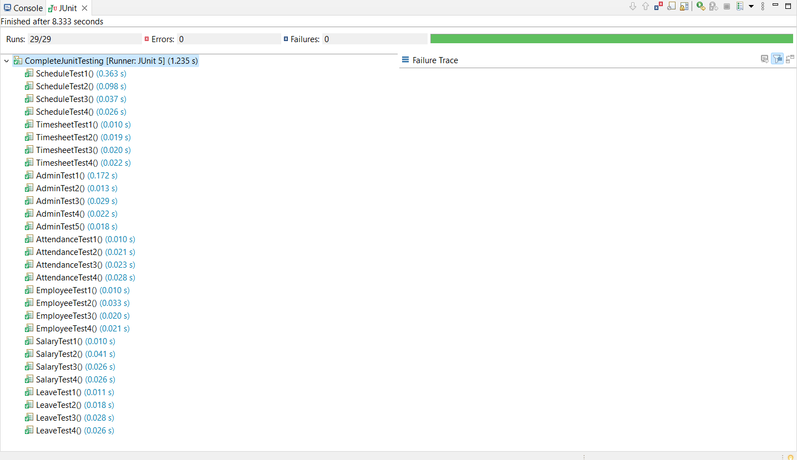
JUnit Testing Result

Slide 67


Slide 68

Future scope
This project has many future applications like it can be used in any of the Retail Outlet of Any Type of companies.
This project was build keeping in mind all the requirements of these outlets and they can be implemented in any such type of organization with very few modifications.

Slide 69

Conclusion
“Employee Payroll Management System” is developed to achieve maximum efficiency and reduce the time taken to handle the Payroll activity.
It is designed to replace an existing manual record system thereby reducing time taken for calculations and for storing data.
The implementation of the system in the organization will considerably reduce data entry, time and also provide readily calculated reports.

Slide 70
THANK YOU !

